Slide 1
Team Assignment 3
Section A Team 09
Ford Danielsen, Rishabh Kumar, Sundar Ryali, Van Xu, Evelyn Zhang

Slide 2
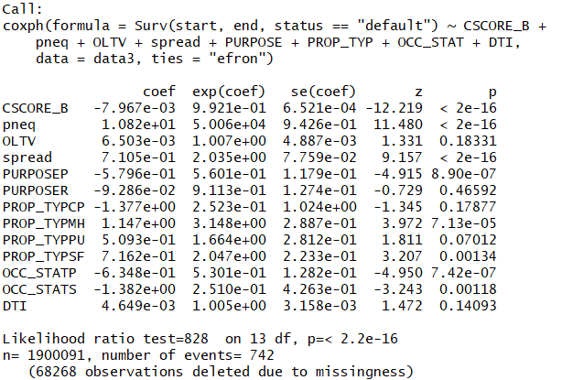
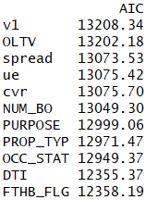

Model 1 - Default Model Estimates
We started with CSCORE_B and pneq, and added one more covariate each time
After comparing the AIC of the 11 model, we found that the addition of covariate “ue”, “cvr”, “FTHB_FLG” did not decrease AIC
Plots of the “Schoenfeld residuals” of some covariates are in the next slide
We also excluded “NUM_BO”, which had p-value ≈ 1
Notes:
For selecting covariates for the default model, we started with CSCORE_B and pneq, and add other covariates one by one (so, there are 2 covariates in model v1, and credit score + pneq + loan-to-value rate, and etc, ended up with all 12 covariates in the last model)
Then we compared the AIC of the 11 models and we found that the addition of covariate “ue”, “cvr”, “FTHB_FLG” did not decrease AIC
unemployment rate; refinance incentive; credit score FICO; pneq (probability of negative equity)
We excluded the three covariates from the final default model, and we run a model with other 9 covariates.
Later, we also excluded “NUM_BO”, which all had p-value ≈ 1. You can our final output on the right, where our final default model consists of 8 covariates
with an AIC about 12 thousand and 400 hourand
Plots of the “Schoenfeld residuals” of some covariates are in the next slide; shang feld

Slide 3
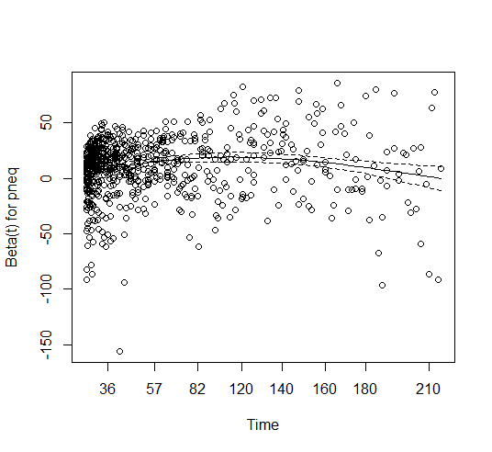
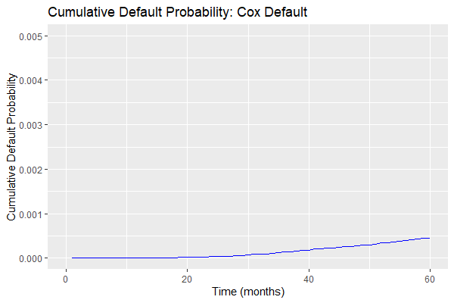
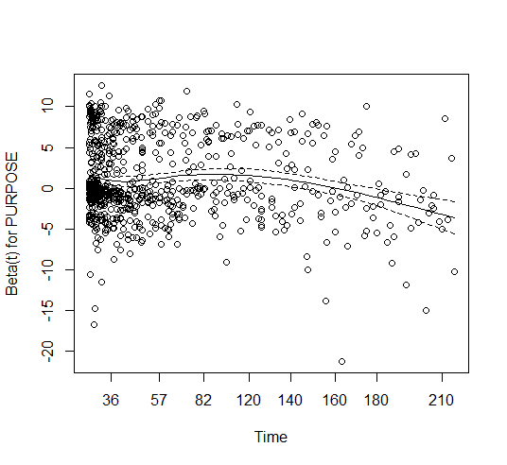
Model 1 - Cumulative Default Probabilities

Slide 4
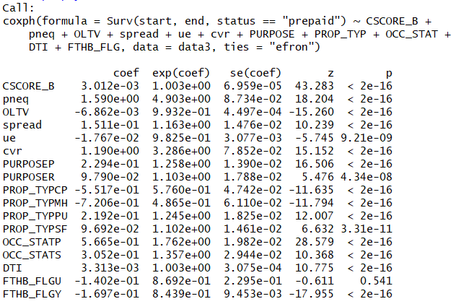
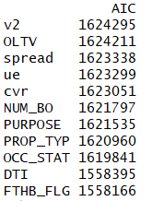

Model 2 - Prepayment Model Estimates
We started with CSCORE_B and pneq, and added one more covariate each time
After comparing the AIC of the 11 model, we found that the addition of all covariates would decrease AIC
We also excluded “NUM_BO”, which most had p-value >0.1

Slide 5
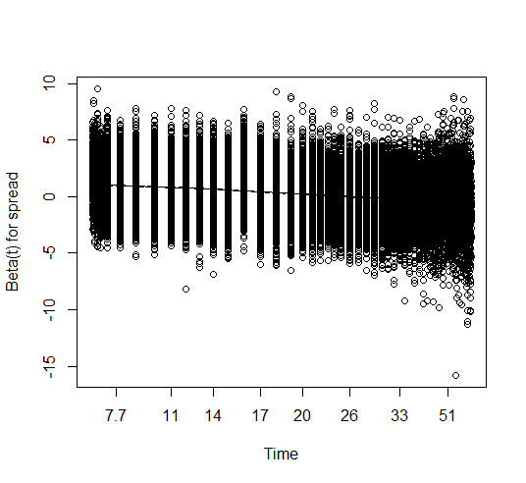
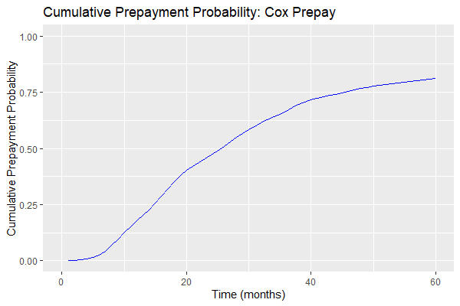
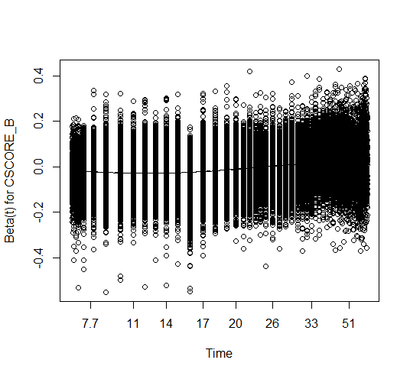
Model 2 - Cumulative Prepayment Probabilities

Slide 6
Zoom Link
https://duke.zoom.us/rec/play/j0guAu-X1UGbvjtpkWJPtYbg60jTGcXCoyUma6Xm87PR4QkynU2sziWPNLAwkUK7Ga5EO3RW1DNiFqG9.1IbSxL2eu1s9zUKm?startTime=1650581918000&_x_zm_rtaid=xP9CoELqQZaN0-aTnWs6KQ.1650580533914.76b80bb429f14e2d5e42542959a74c6c&_x_zm_rhtaid=651
Presenters:
Evelyn Zhang (Model 1 Estimates)
Van Xu (Cumulative Probabilities)
Rishabh Kumar (Model 2 Estimates)

